Slide 1
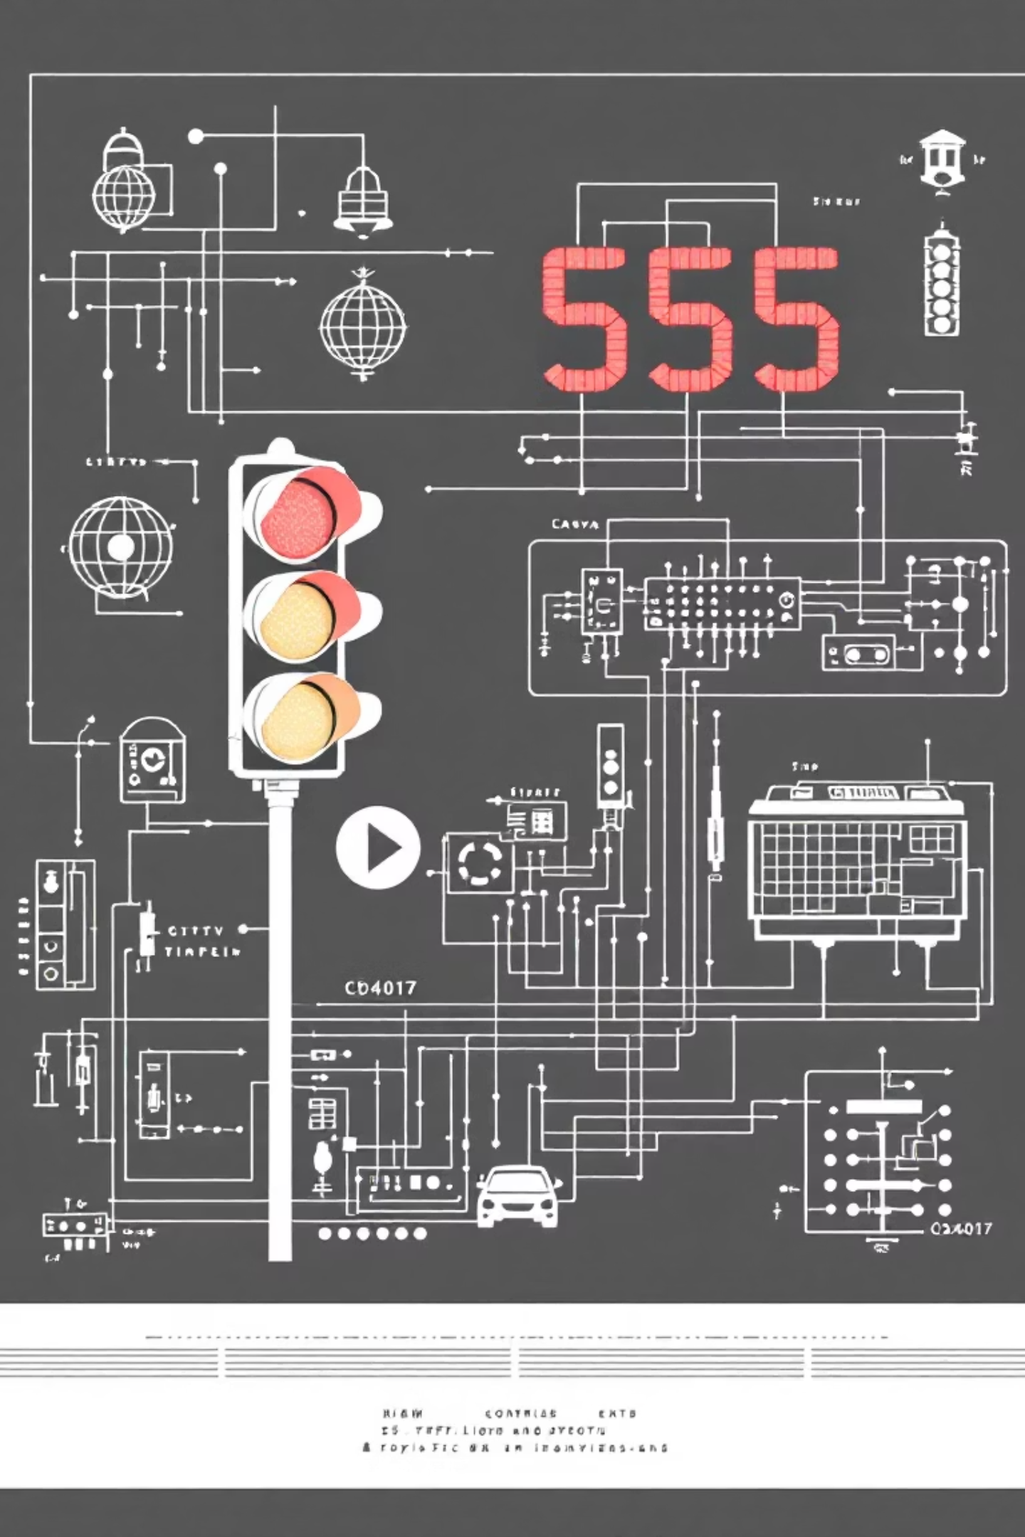
Traffic Light Control System Using 555 Timer and CD4017
Name: [Your Name]
Class / Section: [Your Class/Section]
Subject: Electronics Engineering Principles
Teacher’s Name: [Teacher’s Name]

Slide 2

Introduction to the System
A Traffic Light Control System is an electronic circuit engineered to automatically manage traffic signals, ensuring smooth flow and enhanced road safety.
Essential for Road Safety
Traffic lights are crucial for preventing accidents and optimising traffic flow in urban environments.
Microcontroller-Free Design
This project demonstrates a functional system using fundamental electronic components, bypassing the need for complex microcontrollers.
Sequential LED Operation
The system precisely controls the switching sequence of Red, Yellow, and Green LEDs, mimicking real-world traffic signals.
Core Components
Timing is handled by a 555 timer IC, while the CD4017 decade counter orchestrates the LED sequence.

Slide 3


Objectives of the Project
Automatic Traffic Light Control System
Our primary goal is to engineer a reliable and fully automated traffic light control system.
Understanding 555 Timer Astable Mode
To gain in-depth knowledge of how the versatile 555 timer operates in its astable configuration, generating continuous pulses.
Exploring CD4017 Decade Counter
To thoroughly investigate and comprehend the operational principles of the CD4017 decade counter, a key component in sequential logic.
Simulating Real-World Traffic
To accurately simulate the dynamic behaviour of traffic signals using light-emitting diodes (LEDs) for visual feedback.

Slide 4
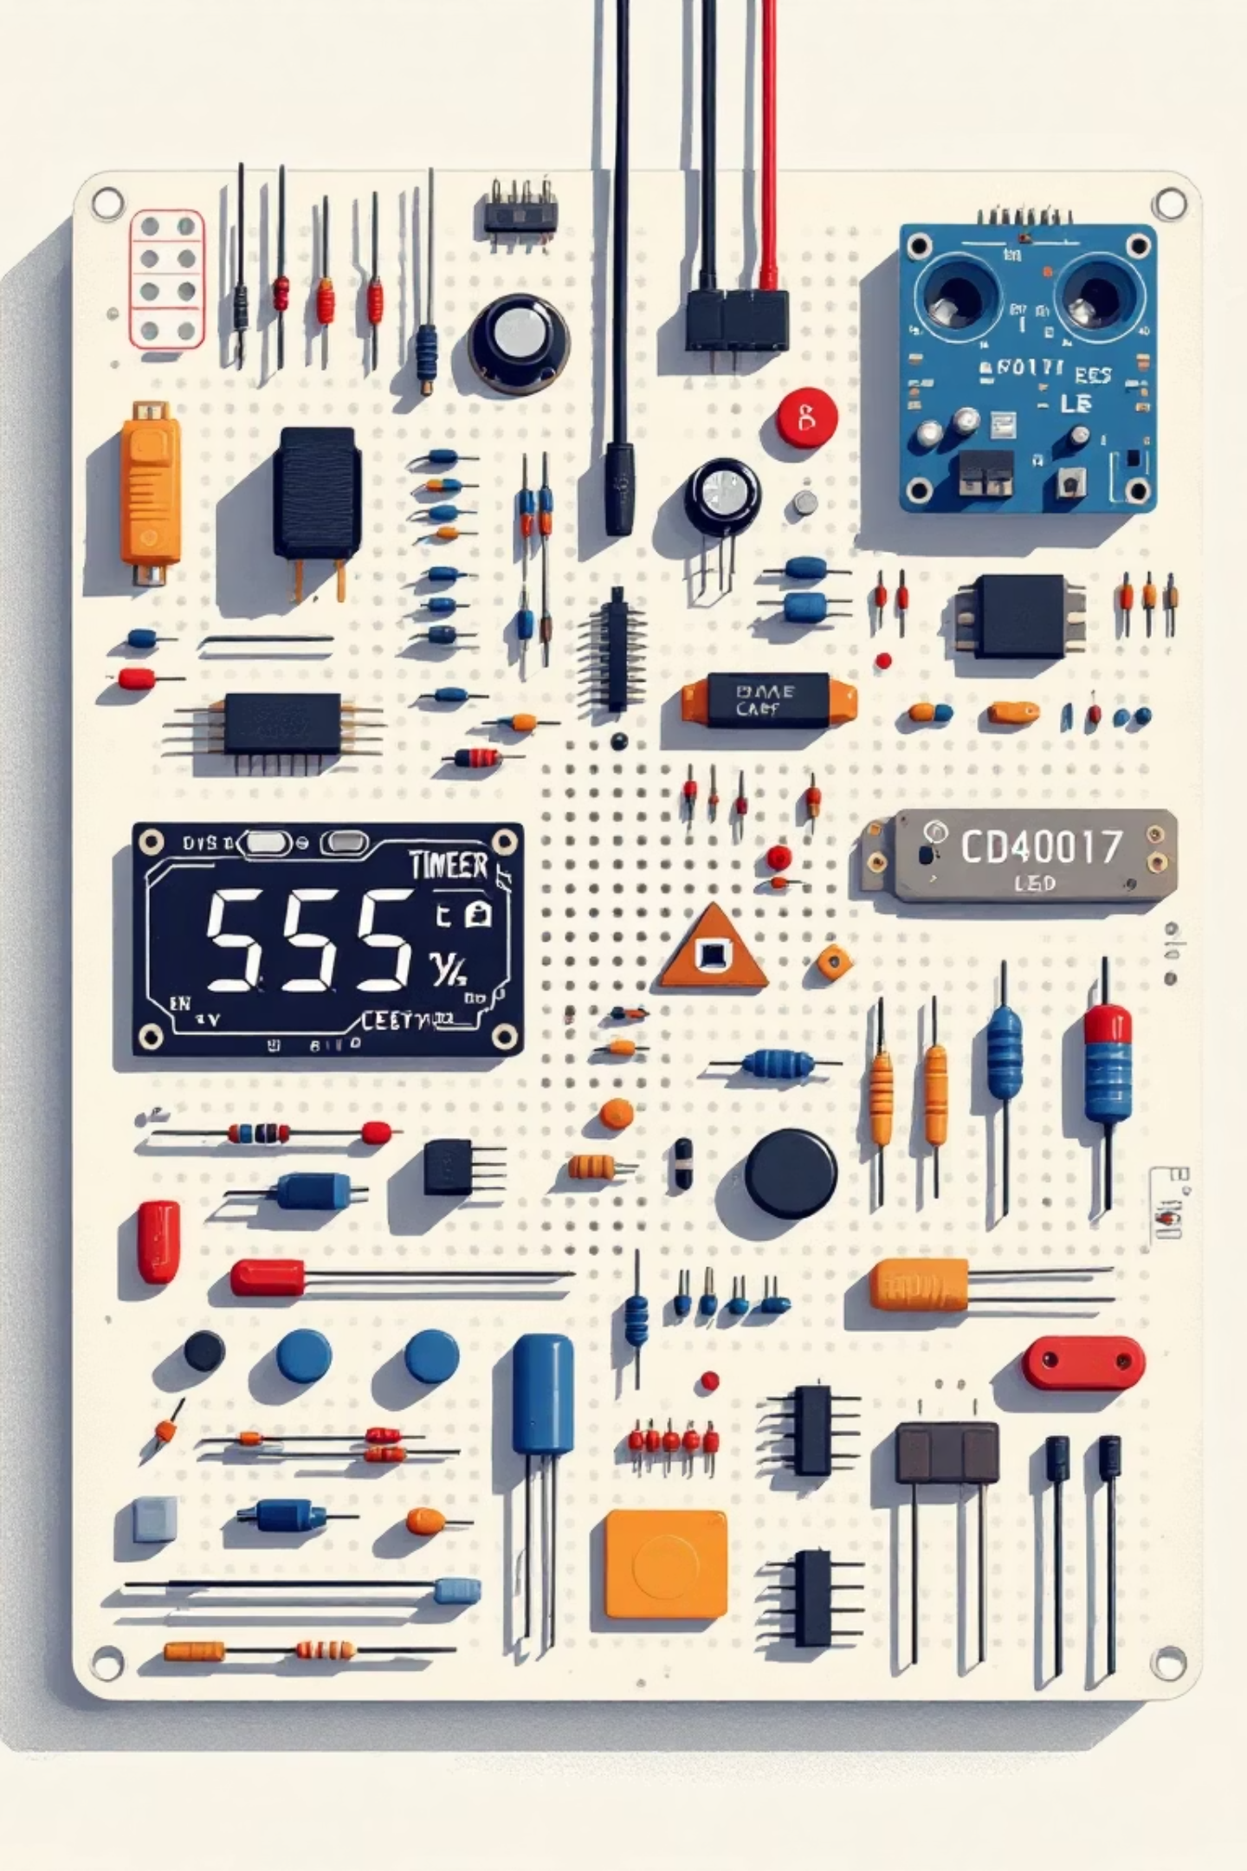
Essential Components Required
Building this traffic light system requires a selection of readily available electronic parts.
Solderless Breadboard
100µF Capacitors × 2
555 Timer IC
Red LED
CD4017 Decade Counter IC
Yellow LED
100kΩ Variable Resistor
Green LED
100Ω Resistors × 3
Blue LED (indicator)
1kΩ Resistor
1N4148 Diodes × 11
10kΩ Resistor
1N4007 Diode
9V Battery and Battery Clip

Slide 5
Working Principle: The Heart of the System
This system harnesses the power of sequential logic to mimic real traffic patterns.
555 Timer: Pulse Generation
1
The 555 timer is configured as an astable multivibrator, producing a continuous stream of ON–OFF clock pulses.
Feeding the Counter
2
These precisely timed pulses are then directed to the input of the CD4017 decade counter IC.
CD4017: Sequential Activation
3
The CD4017 sequentially activates its output pins, one after another, in response to each incoming clock pulse.
LED Sequence: Traffic Flow
4
LEDs connected to these outputs illuminate in a predefined order: Red → Yellow → Green → Yellow → Red, replicating a standard traffic light cycle.

Slide 6





Role of Main Components
555 Timer IC
CD4017 IC
Diodes
The heart of the timing mechanism, responsible for generating precise and continuous clock pulses essential for sequential operation.
A CMOS decade counter that distributes incoming pulses sequentially to its ten output pins, controlling the LED illumination order.
Crucial for circuit protection, preventing reverse current flow and isolating different output paths to ensure correct LED behaviour.
Resistors
Capacitors
Used to limit the current flowing through LEDs and ICs, safeguarding them from damage due to excessive voltage or current.
These components play a vital role in setting the timing intervals for the 555 timer and smoothing out voltage fluctuations within the circuit.

Slide 7
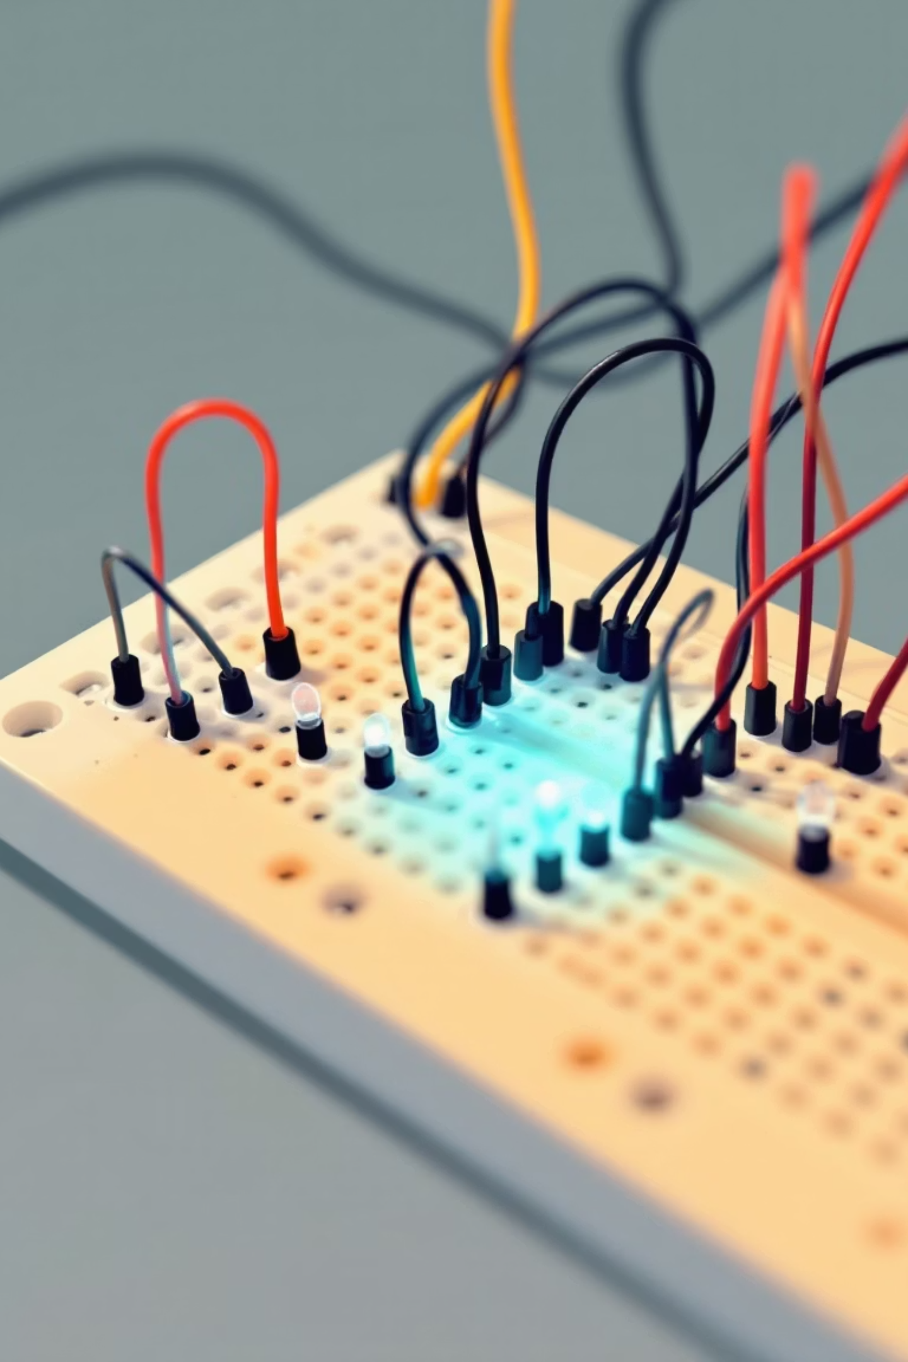
Hardware Implementation: Bringing the Design to Life
Following successful simulation, the theoretical design was translated into a tangible circuit.
1
2
Breadboard Assembly
Circuit Diagram Adherence
The circuit components were carefully assembled and interconnected on a solderless breadboard, allowing for easy modifications.
Each component was placed and wired precisely according to the detailed circuit schematic, ensuring correct electrical connections.
3
Real-World Validation
Upon power-up, the physical circuit demonstrated the exact same LED sequencing behaviour observed during the simulation phase.
_(A high-resolution photograph of the actual project would be inserted here.)_

Slide 8
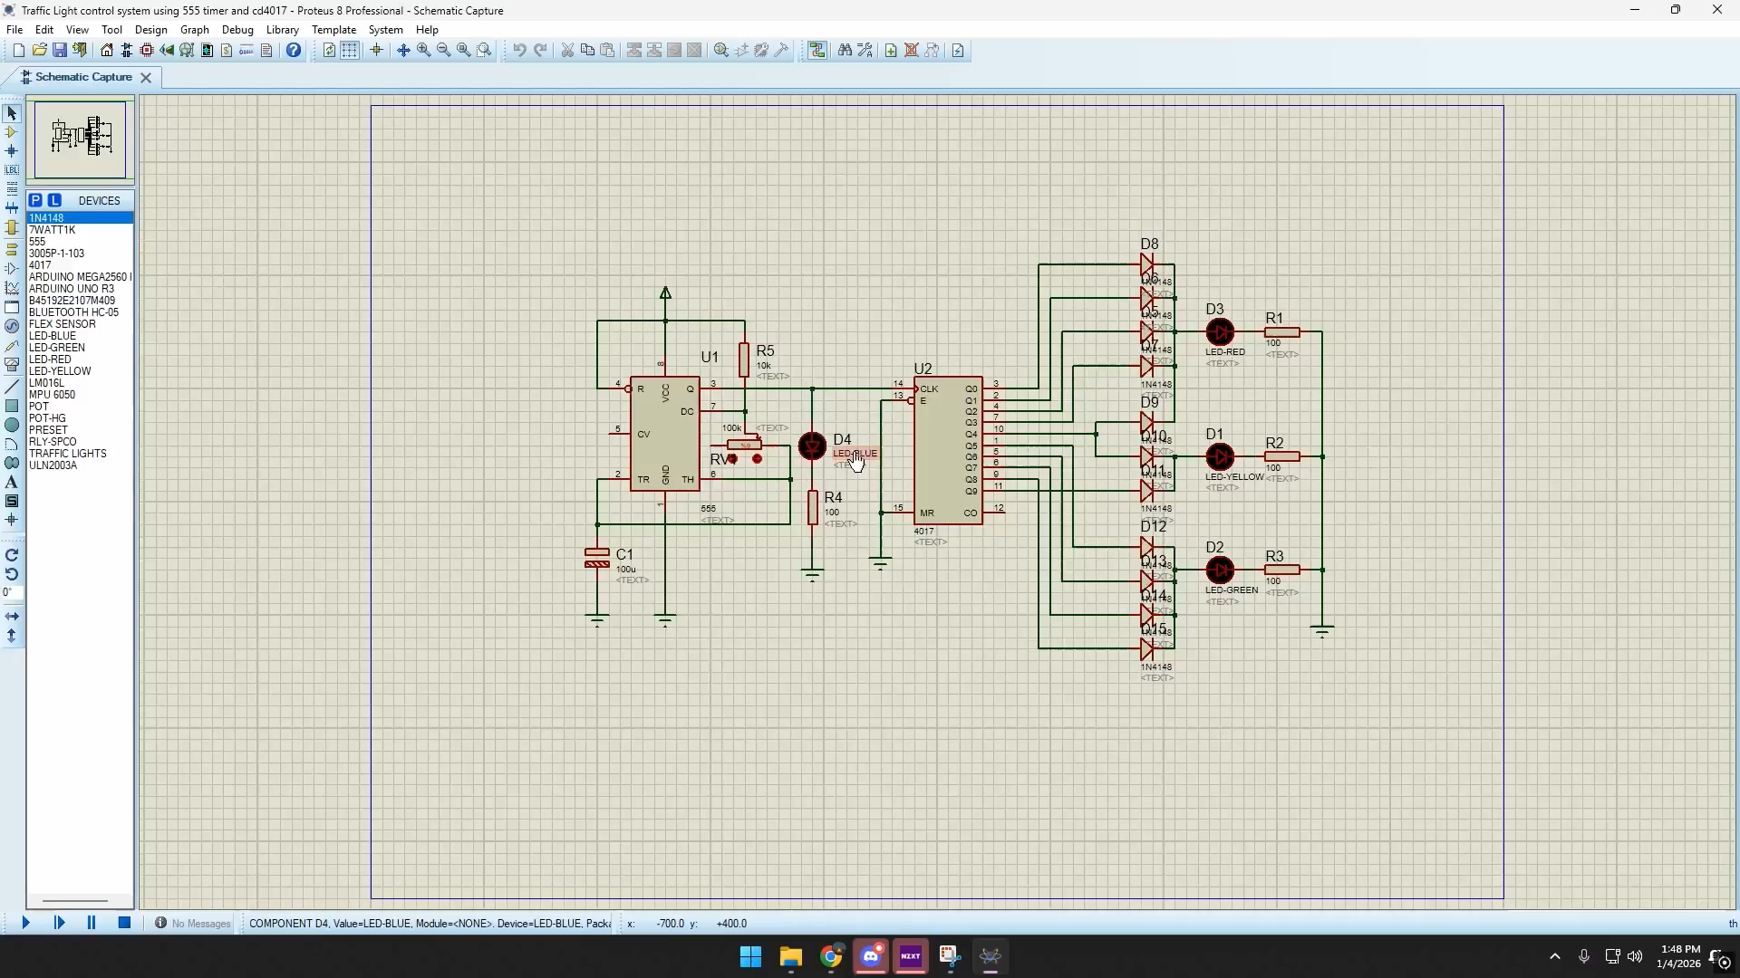




Precision : Simulation and Advanced Materials
This is the simulation in
to showcase the system of Traffic lights
Optimised Design
Material Innovation
Leveraging simulations to refine product designs for superior performance and efficiency.
Exploring the integration of novel materials with bespoke properties for specific applications.
Enhanced Reliability
Reducing failure rates and extending product lifecycles through rigorous virtual testing.

Slide 9
Output and Results: Observing the Cycle
The implemented traffic light system delivered clear and predictable results, mirroring real-world signal operation.
01
02
03
Red LED Illuminates
Yellow LED Transition
Green LED for Movement
Initially, the Red LED lights up, signifying 'Stop' for the main traffic flow.
The Yellow LED briefly glows, indicating an impending change from Red to Green or Green to Red.
The Green LED turns ON, signalling 'Go' and allowing traffic to proceed.
04
05
Automatic Repetition
Adjustable Timing
This sequence of Red, Yellow, Green, and Yellow repeats seamlessly, ensuring continuous traffic management.
The duration of each light phase can be precisely fine-tuned by adjusting the 100kΩ variable resistor.

Slide 10
Advantages of Our Design
This project offers several compelling benefits, particularly for educational and basic application scenarios.
Simple & Cost-Effective
No Microcontroller Needed
Easy to Understand
The design is straightforward to implement and utilises readily available, inexpensive electronic components.
The circuit's operation is transparent, making it an excellent learning tool for foundational electronics concepts.
Achieves automatic control without complex programming, relying solely on analogue and digital logic ICs.
Ideal Educational Project
Adjustable Timing
Perfect for beginners in electronics, providing hands-on experience with fundamental components and circuit design.
Offers flexibility to modify the duration of each traffic light phase, allowing for customisation and experimentation.

Slide 11

Real Life Applications
Smart Cities Infrastructure
Advanced Manufacturing & Robotics
Optimizing traffic flow, managing public services, and enhancing urban planning through data collection and analysis.
Automating production lines, predictive maintenance, and quality control in industrial settings to boost efficiency.
Healthcare & Medical Diagnostics
Environmental Monitoring
Assisting in real-time patient monitoring, accelerating disease diagnosis, and personalizing treatment plans.
Tracking air and water quality, climate patterns, and wildlife to support conservation efforts and disaster prediction.
Autonomous Vehicles & Logistics
Enabling self-driving cars, optimizing delivery routes, and managing complex supply chains efficiently.

Slide 12
Limitations
Fixed sequence operation
Cannot detect traffic density
Manual timing adjustment required
Suitable mainly for small-scale demonstration

